Slide 1
Game Development
Ricard Pillosu - UPC

Slide 2

Contents
Learning goals
What we will learn
Evaluation
Rules
Tools
Observations

Slide 3
Learning Goals
Become proficient with C++
Understand the building blocks of video games
Get into data driven programming
Understand isometric perspective
Develop debug tools
First glimpse into GUI programming

Slide 4
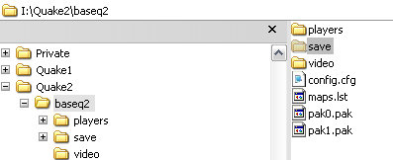
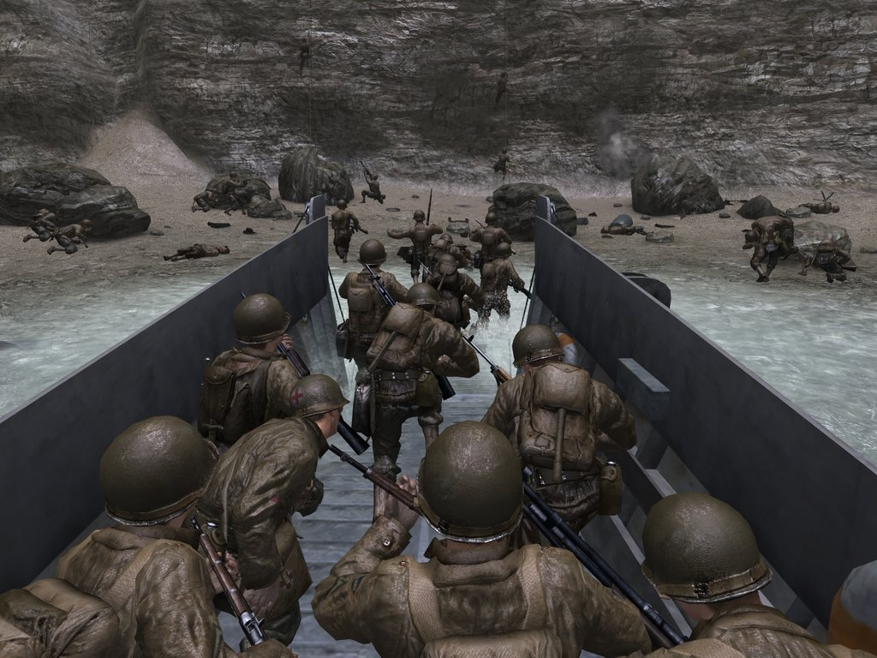
Resource handling like Quake to spawn mods like this

Slide 5
What we will learn
Resource Management
Load / Save
Loading maps (XML)

Slide 6
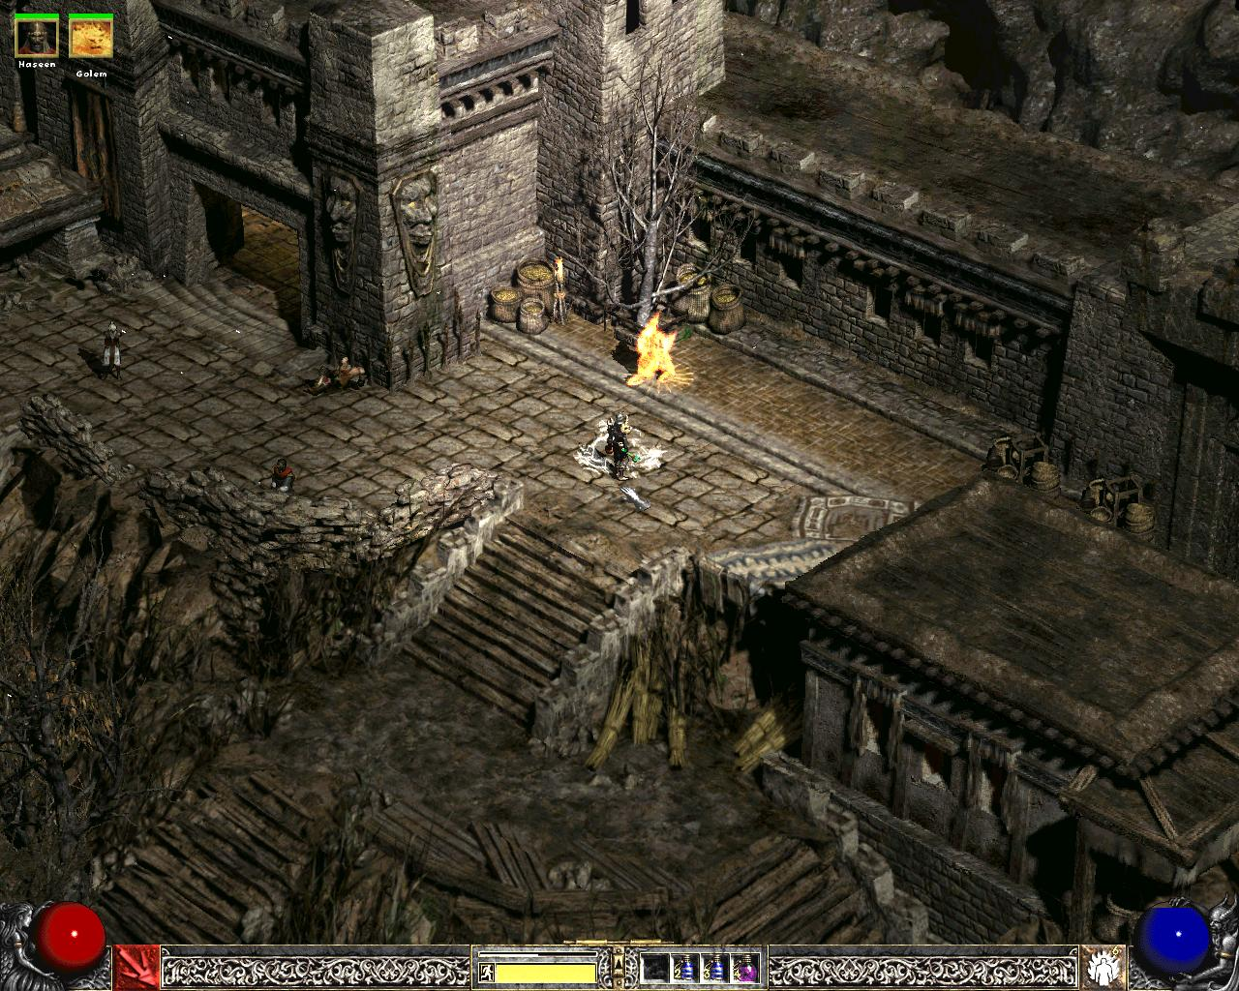
Map loading and rendering || Diablo 2

Slide 7
What we will learn
Orthographic vs. Isometric
Meta information on maps
Pathfinding!

Slide 8

Max Payne

Slide 9
What we will learn
FPS control
Game Logic Time control
Entity Management

Slide 10
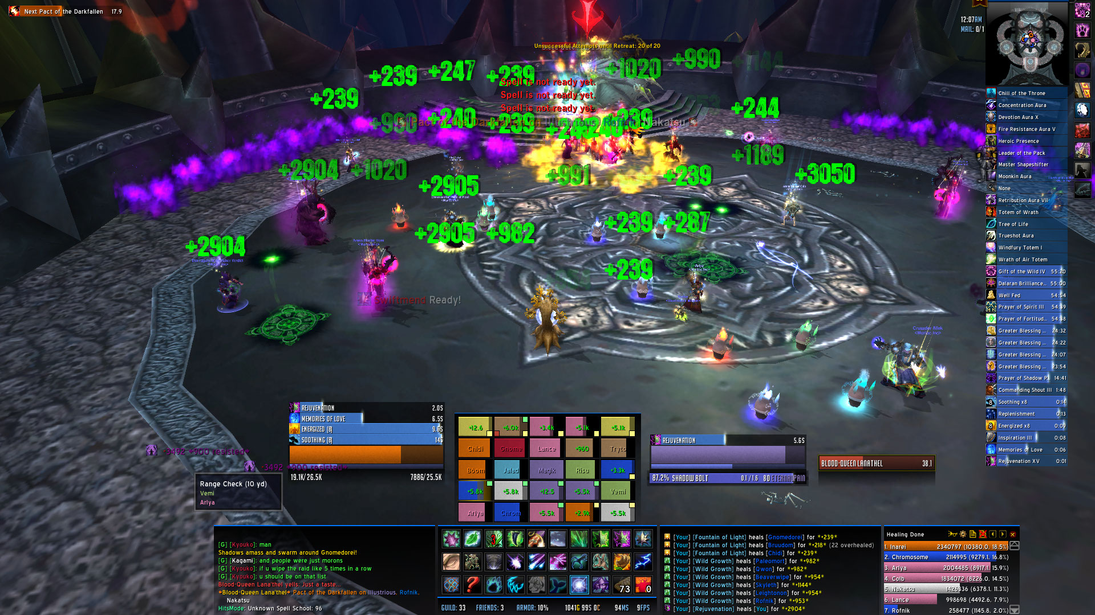
GUI - WoW

Slide 11
What we will learn
GUI:
Labels
Buttons
Text Input

Slide 12
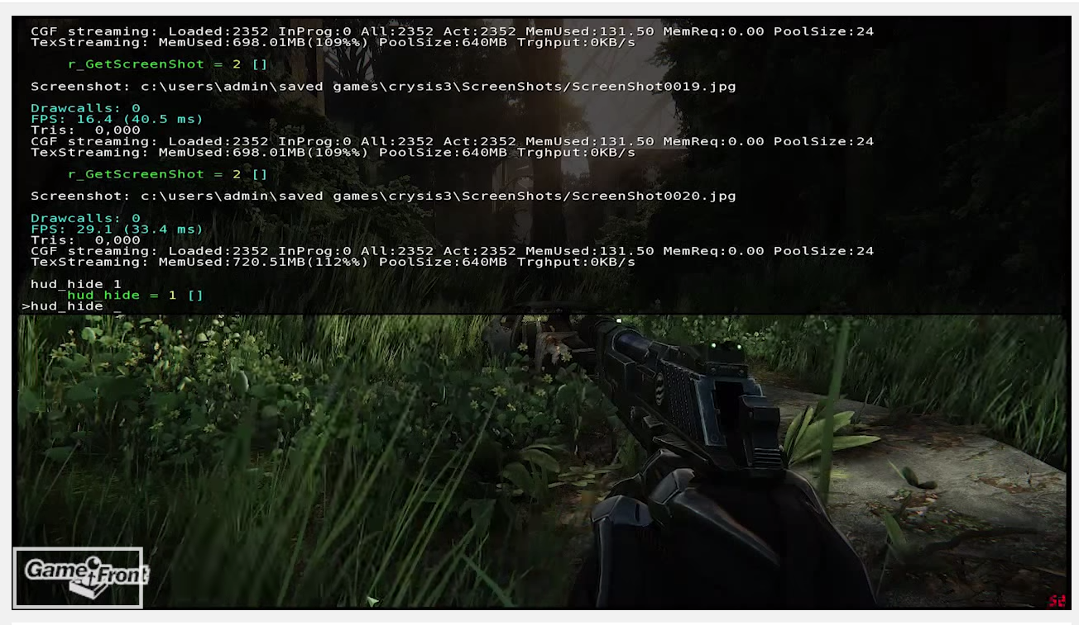
Quake style console || Crysis console

Slide 13
What we will learn
Performance analysis
Development console
Cvars for configuration
Tweak menu

Slide 14
Evaluation
First exam:
Counts as 20%
October 16th
Resource Management
XML Parsing
Map Rendering
Second exam:
Counts as 20%
November 13th
Pathfinding
Time control
Entity management

Slide 15
Evaluation
Third exam:
Counts as 20%
December 4th
GUI: Labels
GUI: Buttons
GUI: Text Input
Final exam:
Counts as 40%
January 11th - 22nd
Revaluation exam:
Counts as 100%
February 1st - 8th

Slide 16
Rules
Work is individual
… but teamwork is important, share and discuss!
Code is expected to be:
Clear
Consistent
Optimal

Slide 17
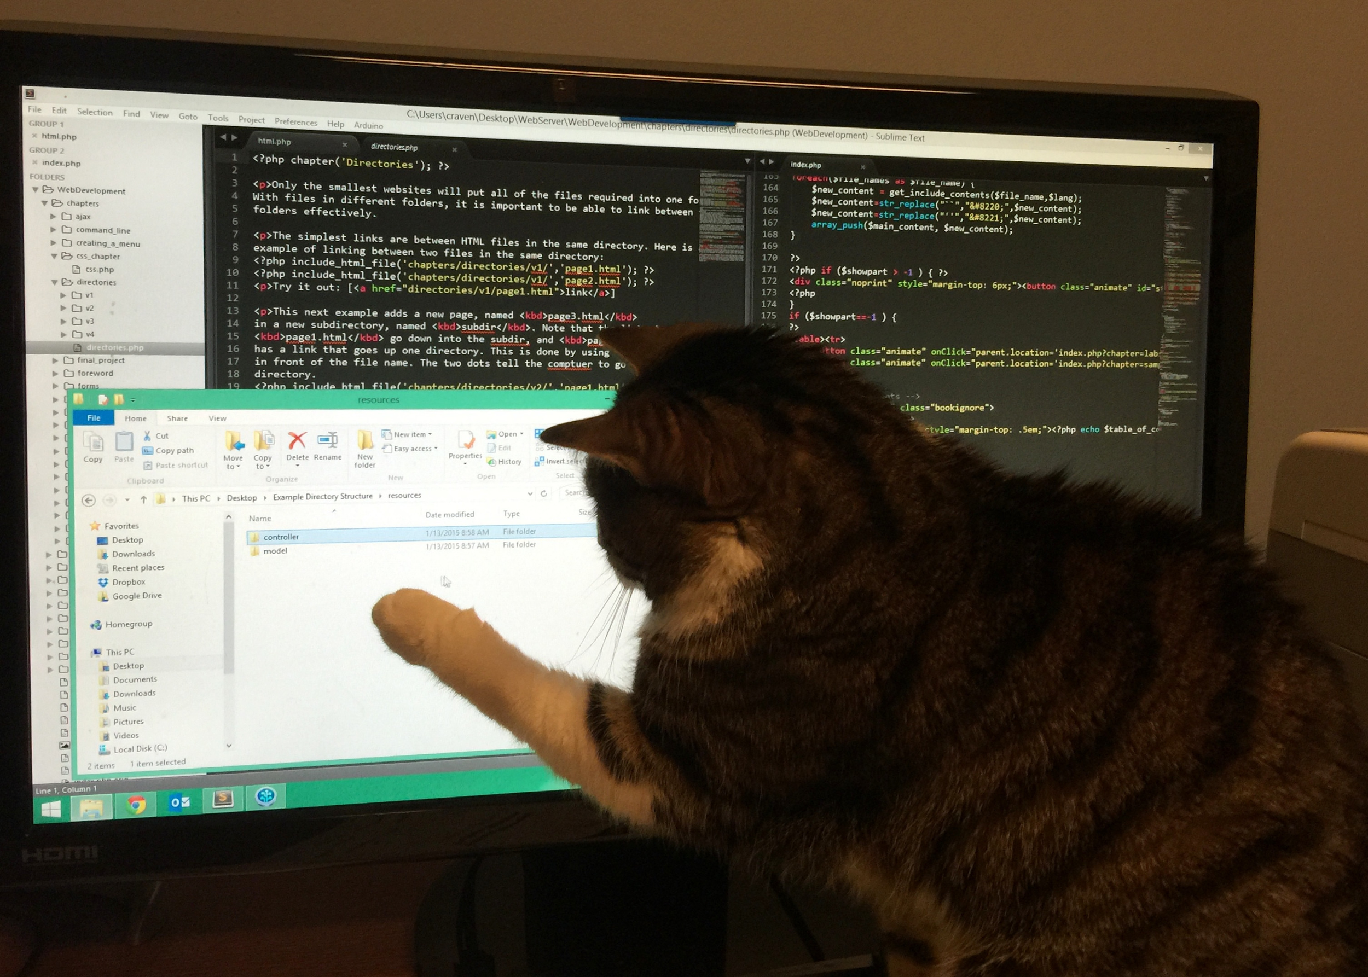
Rules
Exploration is encouraged, bring your ideas!
Homework is the main learning tool
During exams:
You have all your code available
No internet connection
No teamwork :)

Slide 18
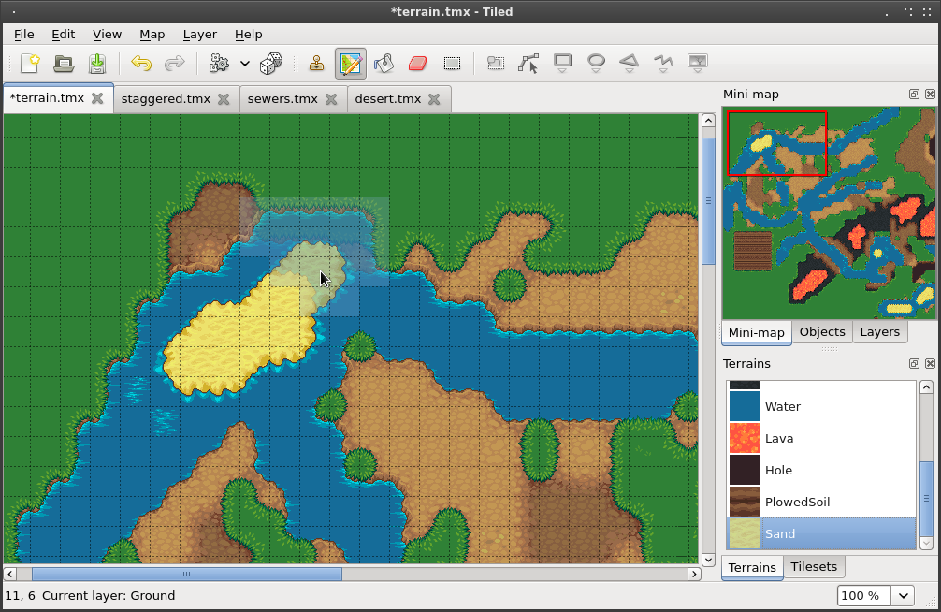
Tools
We will build on last year code structure:
Visual Studio 2013
Github
Tiled
Dr. Memory

Slide 19
Observations
We will learn coding for video games
Exploration and work at home is key
You will start understanding the games you play
All those building blocks will be used on Project II Subject next semester
Have fun! :)
https://www.youtube.com/watch?v=nxtMnaDp6M4

Slide 20
Homework
Review C++ material from Programming II
Class, Encapsulation and Polymorphism
Create a new vec3 class
Create a method in linked list to add its data to a dyn array
Create a method in the dyn array to add its data to a linked list

